Slide 1
ORCID & SciENcv
July 2023

Slide 2
ORCID = Open Researcher and Contributor Identifier
ORCID is a global, not-for-profit organization.
ORCID strives to enable transparent and trustworthy connections between researchers, their contributions, and their affiliations by providing a unique, persistent identifier for individuals to use as they engage in research, scholarship, and innovation activities.
In 2019, NIH, AHRQ, and CDC announced that individuals supported by research training, fellowship, research education, and career development awards will be required to have ORCID iDs (Open Researcher and Contributor Identifiers) beginning in FY 2020.
An ORCID is not required to create documents in SciENcv, but we recommend creating one. NIH strongly recommends getting an ORCID ID and link to eRA Commons ID in eRA Commons Profile.

Slide 3
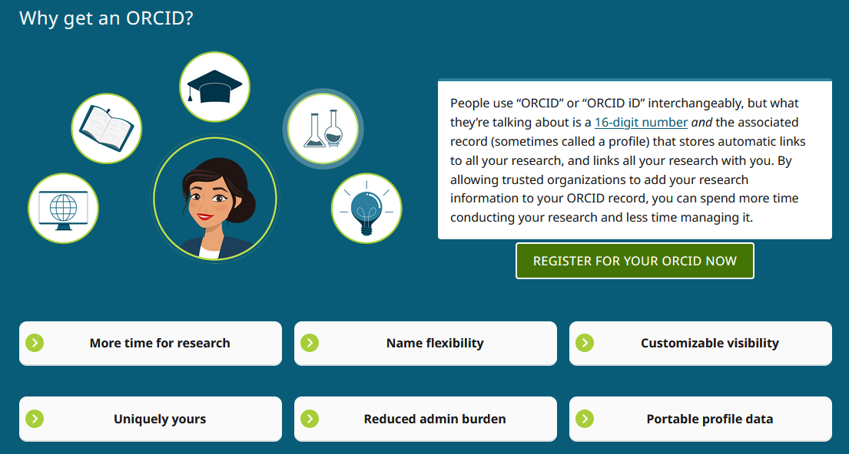
ORCID Resources
https://info.orcid.org/researchers/ - Great information and graphics (like below) including intro videos
https://spo.byu.edu/00000183-fbba-d2de-abb3-fbfa9ab40000/new-orcid-instructions-10-20-2022-pdf - Step by Step Instructions

Slide 4
Delegating ORCID Permissions
You can grant permission to one or more trusted individuals to update your ORCID record, acting as a delegate or proxy for managing your account. Other ORCID users can grant permission for you to update their records. A trusted individual does not need to be another researcher, but must have an ORCID iD.
For more information: https://support.orcid.org/hc/en-us/articles/360006973613

Slide 5
SciENcv = Science Experts Network Curriculum Vitae
SciENcv is a free profile service which is offered by NCBI (National Center for Biotechnology Information) of the National Library of Medicine (within NIH).
SciENcv within My NCBI helps you create online professional profiles that can be made public to share with others. In SciENcv you can document your education, employment, research activities, publications, honors, research grants, and other professional contributions. My NCBI users can create multiple SciENcv profiles in official biographical sketch formats, for the National Institutes of Health (NIH), the National Science Foundation (NSF), and the Institute of Education Sciences (IES), which can be used for grant submissions. In addition, the SciENcv application can be used to create the official NSF Current and Pending Support document.
NIH eRA Commons, NSF, and ORCID account holders who have linked their accounts to NCBI can populate their SciENcv profiles with the information stored in their eRA, NSF, or ORCID accounts. The information transferred to SciENcv can be changed, hidden, augmented, or deleted. SciENcv users control the content displayed in their SciENcv profiles.
https://www.ncbi.nlm.nih.gov/sciencv - SciENcv homepage
https://www.ncbi.nlm.nih.gov/sciencv/help/ SciENcv help page
https://www.ncbi.nlm.nih.gov/books/NBK154494/ - SciENcv Help Manual
https://www.youtube.com/watch?v=G_cKSRr7TJ4 - Integrating SciENcv with ORCID
https://brightspotcdn.byu.edu/3c/31/93b8a3f341979b01ca69b337b3c8/sciencv-faqs-2023.pdf- SciENcv FAQs

Slide 6
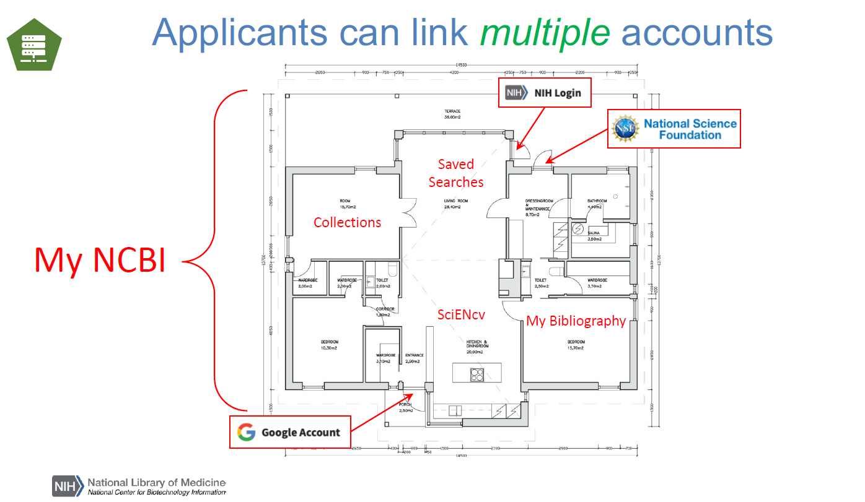
SciENcv is a tool that exists within a house of tools – within My NCBI.

Slide 7
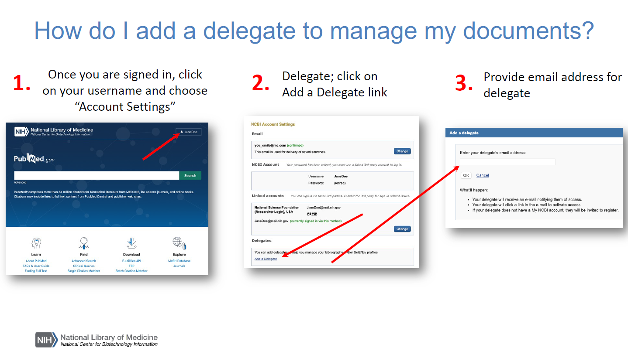

Slide 8
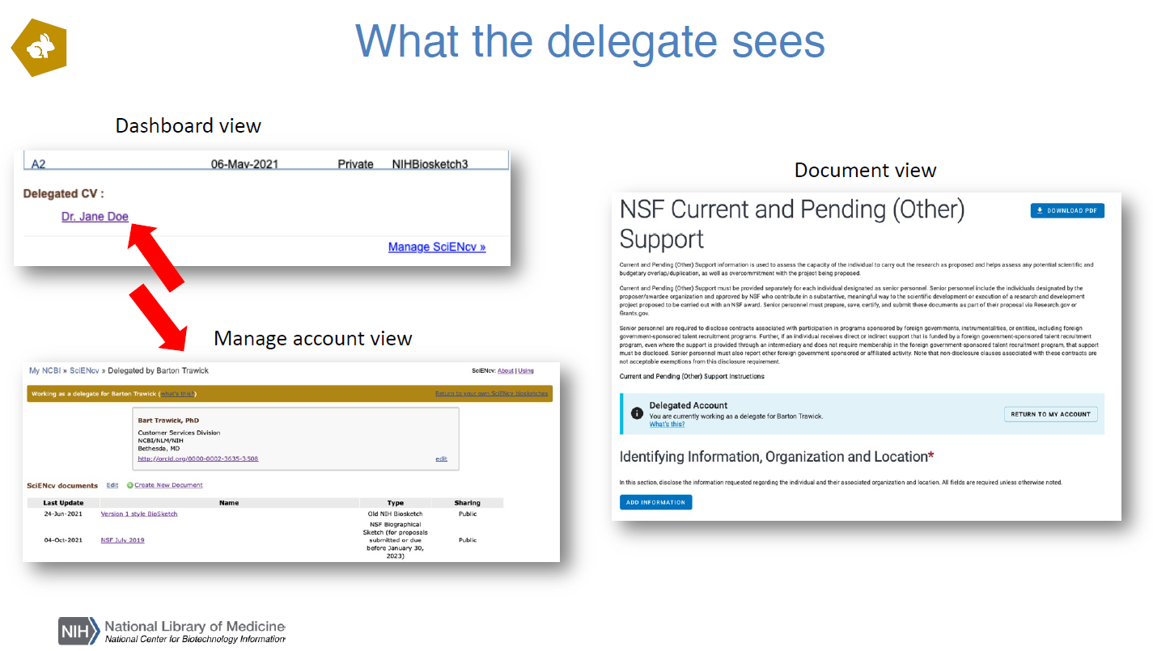

Slide 9

Creating SciENcv Biosketches
Sign in to NCBI. Go to the SciENcv portlet and click the hyperlink “Click here.”
There are three ways to create a professional profile in SciENcv:
Through manually entering your information into a SciENcv template
Through making a duplicate of an existing biosketch
Through an automated data feed from an external source

Slide 10
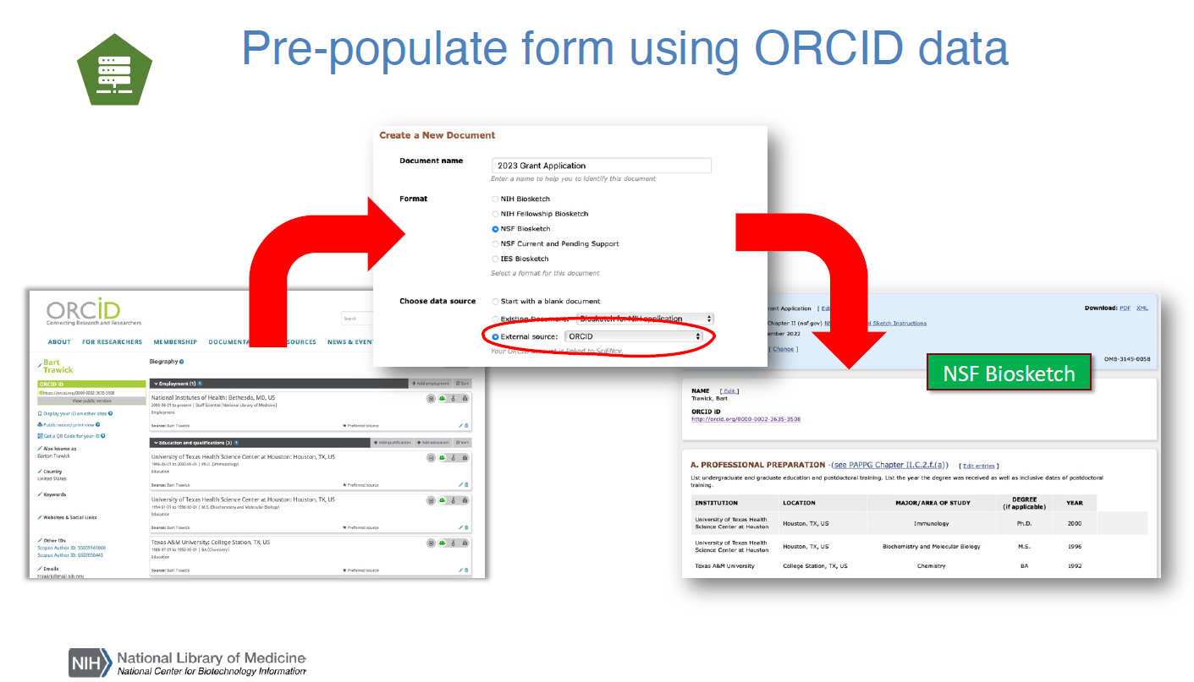

Slide 11
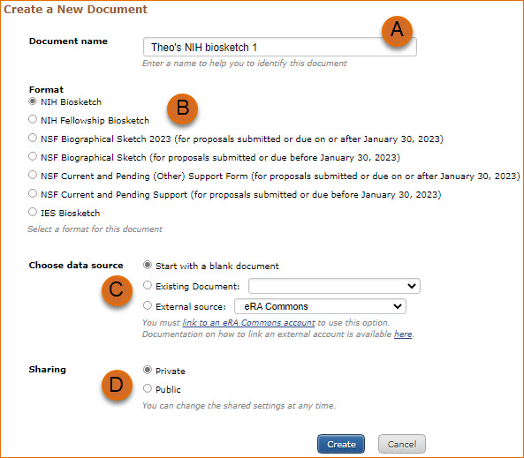
Manually Creating SciENcv Biosketches
1. Enter a name for your new profile (see A ).
2. Select a biosketch format (B).
3. Select “Start with a blank document” (C).
4. Choose to make your profile public or private (D) and click Create. You may change the sharing status for this profile at any time.
https://www.youtube.com/watch?v=hOzltEU0HXw - NSF Biosketch

Slide 12
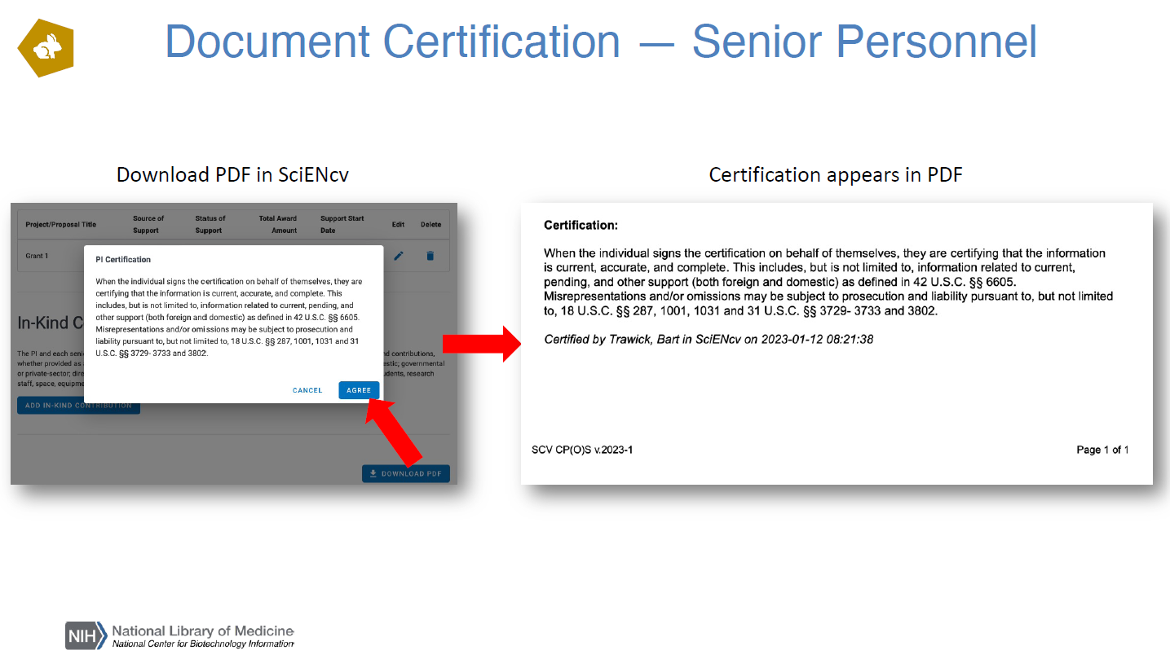

Slide 13
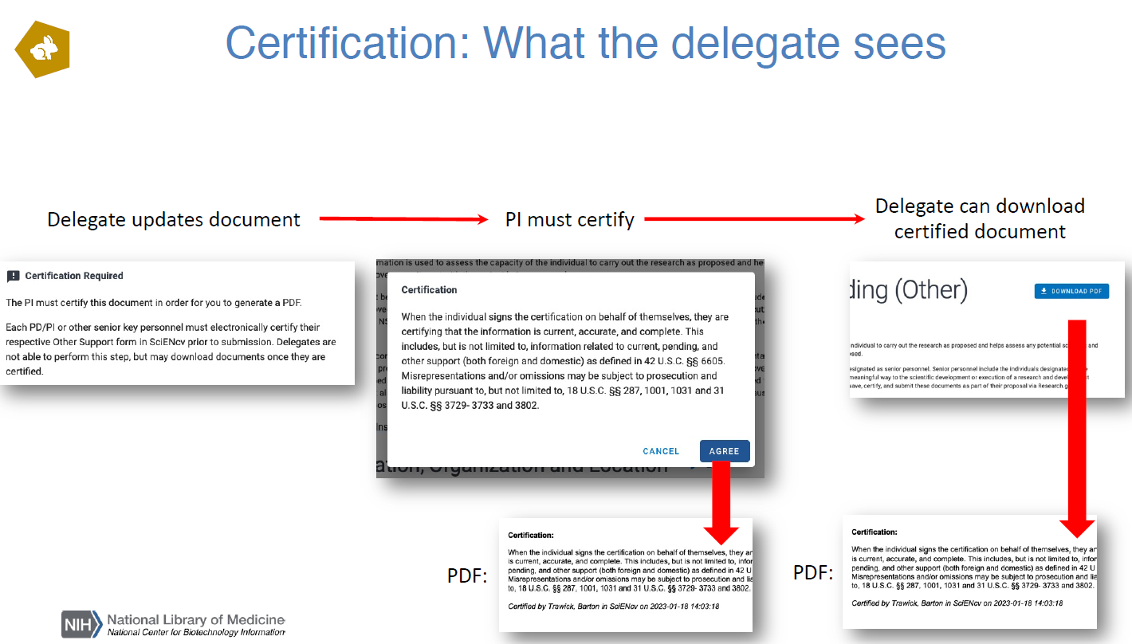

Slide 14
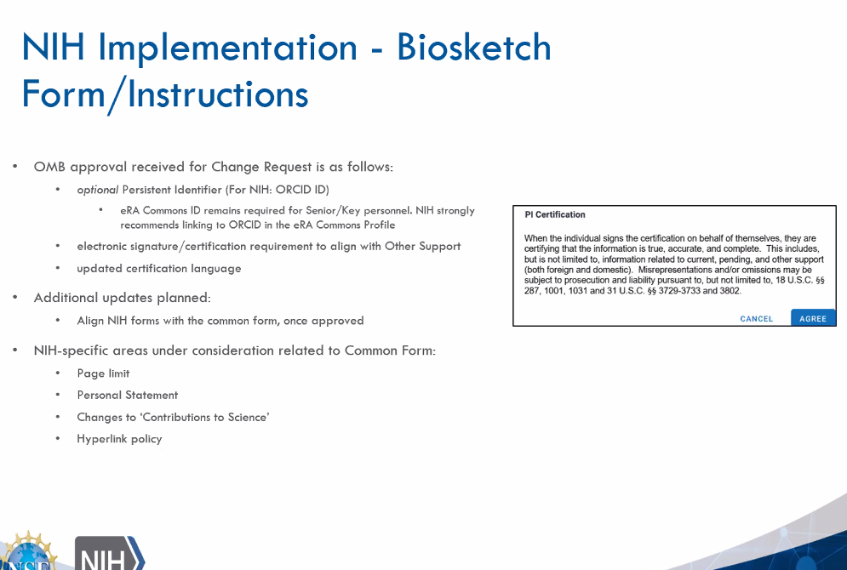
https://www.youtube.com/watch?v=eGyHX85DIcE - NIH Biosketch
Strong recommendation to use ORCID ID and link to eRA Commons ID in eRA Commons Profile.
NIH will adopt SciENcv templates

Slide 15
